Slide 1
EDGEWOOD SOIL & WATER CONSERVATION
DISTRICT
ESTABLISHED SEPTEMBER 27, 1941
2020-2021
ANNUAL REPORT

Slide 2
THE EDGEWOOD SWCD
COVERS 513,860 ACRES IN
SOUTHERN SANTA FE, EASTERN BERNALILLO,
and NORTHERN TORRANCE COUNTIES.
THIS INCLUDES 23,686 ACRES OF
THE CHILILI LAND GRANT AND
26,325 ACRES OF THE PUEBLO OF ISLETA.

Slide 3
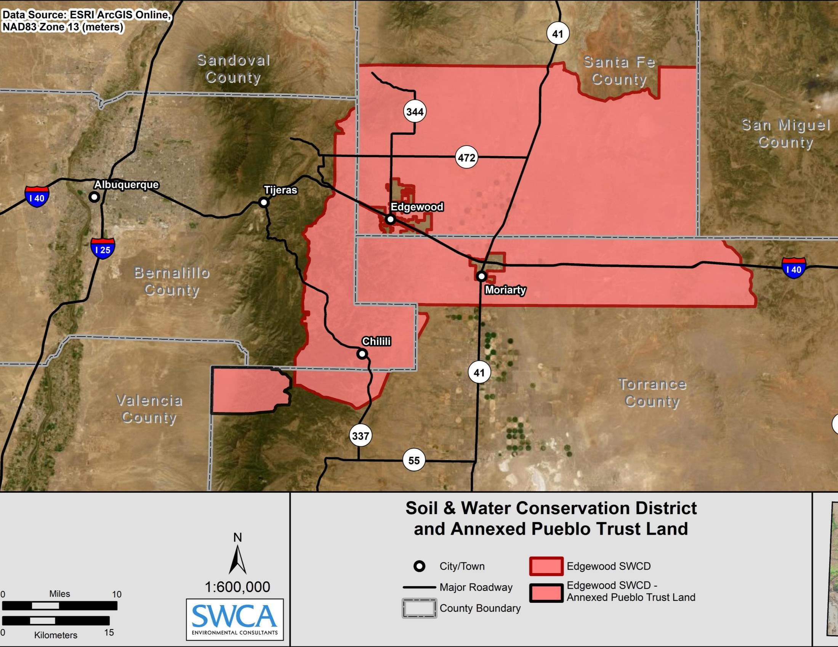

Slide 4
EDGEWOOD Swcd mission statement
THE MISSION OF THE EDGEWOOD SOIL & WATER CONSERVATION DISTRICT
IS TO PROTECT, RESTORE, ENHANCE, AND PROMOTE
THE WISE USE OF NATURAL RESOURCES. THIS WILL BE ACHIEVED THROUGH THE DEVELOPMENT OF PROJECTS,
EDUCATION OF THE PUBLIC,
AND THE COOPERATION OF LANDOWNERS, AGENCIES AND OTHER
POLITICAL SUBDIVISIONS OF THE STATE.

Slide 5
BOARD MEMBERS & STAFF
DAVID KING ~ CHAIRMAN
LEWIS FISHER ~ VICE-CHAIR
BILL KING ~ SECRETARY / TREASURER
MARK ANAYA ~ MEMBER
JUAN SANCHEZ ~ MEMBER
BILL WILLIAMS ~ MEMBER
ART SWENKA ~ MEMBER
BRENDA SMYTHE ~ DISTRICT MANAGER
KELLY SMITH ~ DISTRICT TECHNICIAN
KARLYN BATES ~ ADMINISTRATIVE ASSISTANT
THE BOARD OF SUPERVISORS MEET
THE FIRST THURSDAY OF EACH MONTH AT 10:00 AM.

Slide 6
EDGEWOOD SOIL & WATER CONSERVATION
DISTRICT PROGRAMS

Slide 7
EDGEWOOD SWCD COST-SHARE
EDGEWOOD
SWCD FUNDED
8 CONSERVATION PROJECTS THROUGH THE COST-SHARE PROGRAM
IN THE AMOUNT OF
$35,331.75
REIMBURSEMENTS ARE MADE AT 75%
OF THE TOTAL PROJECT
WITH A MAXIMUM AMOUNT PAID OF
$4500 PER LANDOWNER, PER FISCAL YEAR.

Slide 8
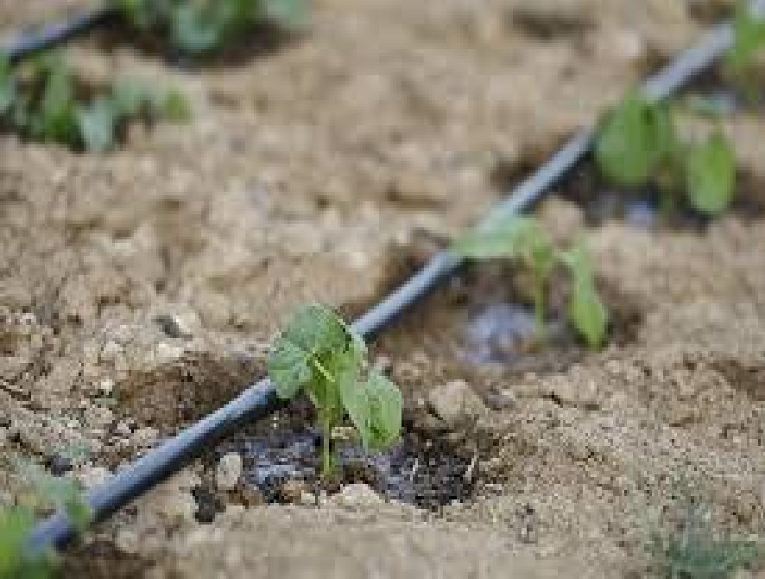
EDGEWOOD SWCD COST-SHARE
SOME APPROVED CONSERVATION PROJECTS INCLUDE:
• RAINWATER HARVESTING
• NATIVE GRASS RESEEDING
• WINDBREAK PLANTING
• DRIP IRRIGATION SYSTEMS
• LIVESTOCK PIPELINE
• EROSION CONTROL
• SLASH CHIPPING
• CHOLLA REMOVAL
• CROSS FENCING
• NOXIOUS WEED MANAGEMENT

Slide 9
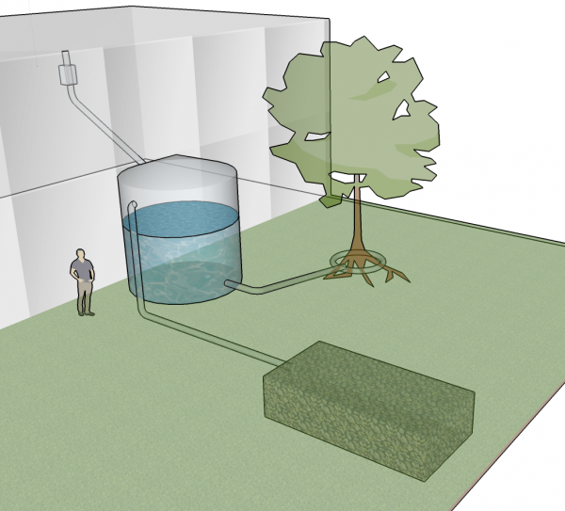
CONSERVATION PROJECTS FUNDED BY EDGEWOOD
SOIL & WATER CONSERVATION DISTRICT
75% OF ALL PROJECTS COMPLETED WITH LOCAL FUNDS
ARE RAINWATER HARVESTING
This Photo by Unknown Author is licensed under CC BY
This Photo by Unknown Author is licensed under CC BY-NC

Slide 10
FOREST HEALTH PROGRAM (FOREST THINNING)
THE FOREST THINNING PROGRAM
PROVIDES FINANCIAL AND TECHNICAL ASSISTANCE FOR WATERSHED MANAGEMENT FOCUSING ON RESTORATION PROJECTS ON PRIVATE AND STATE LAND.
THESE PROJECTS INCLUDE:
▪ FOREST STAND IMPROVEMENT
▪ DEFENSIBLE SPACE
▪ BRUSH MANAGEMENT
▪ FIRE BREAKS

Slide 11
ADDITIONAL PROGRAMS
NATIVE GRASS & FLOWER SEEDS SALES
NMSF FUNDED – NON-fEDERAL LANDS GRANT
WATER TRUST BOARD FUNDING (VIA Claunch-Pinto SWCD)

Slide 12
STAFF TRAININGS THIS FISCAL YEAR INCLUDE
• FOREST RESTORATION
• OPEN MEETINGS ACT TRAINING
• PUBLIC PESTICIDE CERTIFICATION

Slide 13
CERTIFIED PROCUREMENT OFFICER
AS MANDATED BY NEW MEXICO GOVERNOR, SUSANA MARTINEZ IN 2016,
THE EDGEWOOD
SOIL & WATER CONSERVATION DISTRICT’S MANAGER
BECAME A
CERTIFIED PROCUREMENT OFFICER (CPO).
THIS ENSURES STATE PROCUREMENT LAWS ARE BEING FOLLOWED.

Slide 14
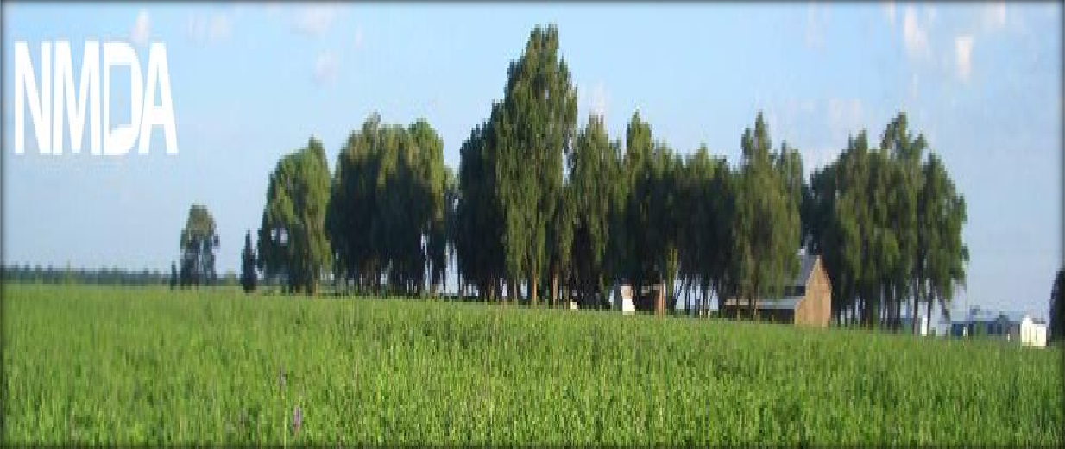
NM PUBLIC PESTICIDE LICENSE
KELLY SMITH & BRENDA SMYTHE HOLD PUBLIC PESTICIDE
APPLICATORS LICENSE.
PUBLIC APPLICATORS ARE INDIVIDUALS WHO WORK FOR A GOVERNMENT AGENCY AND WHOSE DUTIES INCLUDE APPLYING RESTRICTED-USE PESTICIDES.
THE DISTRICT ALSO HAS A SECURE PESTICIDE STORAGE FACILITY THAT IS CERTIFIED BY THE NM DEPARTMENT OF AG.

Slide 15
EDGEWOOD SWCD FUNDING
THE EDGEWOOD SWCD
RECEIVES FUNDING FROM SEVERAL SOURCES
▪ STATE OF NM BASE FUNDING
▪ STATE LAND OFFICE RENTAL
▪ NATIVE GRASS SEED & WILDFLOWER SEED SALES
▪ WATER TRUST BOARD FUNDING
▪ NMSF ~ NON-FEDERAL LANDS (NFL) GRANT
▪ MILL LEVY COLLECTION

Slide 16
2020-2021 FUNDING
$17,434.26
STATE APPROPRIATIONS – NM DEPARTMENT OF AGRICULTURE
$413,448.61
MILL LEVY COLLECTIONS – BERNALILLO, TORRANCE & SANTA FE COUNTIES
$104,192.68
GRANT fUNDING
$9,266.03
NATIVE GRASS SEED & WILDFLOWER SEED SALES
$7,810.00
RENTAL INCOME
,

Slide 17
MILL LEVY COLLECTION
THROUGH A RESOLUTION, THE EDGEWOOD DISTRICT HELD A REFERENDUM TO VOTE FOR A MIL LEVY FOR THE PROPERTY OWNERS WITH THE DISTRICT BOUNDARIES.
A MIL LEVY IS
ONE MIL OF 1/3 OF THE PROPERTY’S NET TAXABLE VALUE.
EXAMPLE:
A $30,900.00 PROPERTY
ASSESSED AT 10,299 (1/3 OF PROPERTY VALUE)
THE MILL LEVY TAX WOULD BE $10.30 PER YEAR. THE MIL LEVY IS ASSESSED
AT THE COUNTY TAX ASSESSOR’S OFFICE.

Slide 18
PARTNERSHIPS
EDGEWOOD SWCD CONTINUES TO WORK WITH US FOREST SERVICE THROUGH
A SIGNED COOPERATIVE AGREEMENT.
CONTINUED PARTNERSHIP WITH SANTA FE-POJOAQUE SWCD FOR CONSERVATION PROJECTS WITHIN SANTA FE COUNTY.
NOXIOUS WEED COORDINATED GROUP THAT
INCLUDES EDGEWOOD SWCD,
SANTA FE-POJOQUE SWCD, CLAUNCH-PINTO SWCD AND NM DEPARTMENT OF TRANSPORTATION.

Slide 19
Edgewood SWCD work through covid-19
Although the District Office was closed due to Governor Grisham’s Covid-19 restrictions, staff continued to work in the office throughout the pandemic.
We followed all the Covid-19 restrictions, i.e., Office disinfected on a regular basis, no public access granted, changes in administrative office as well as manager & technician office design changes to provide the required social distancing for staff.
virtual meetings were held
After the mask mandate was lifted we held meetings with landowners by appointment only.
Telephone grass seed orders were taken via telephone with curbside pickup.

