Slide 1
Edgewood Soil & Water Conservation District Established September 27, 1941

Slide 2
Organization of Edgewood SWCD
A referendum for the formation of the District was carried by popular vote of landowners, as provided in the New Mexico Soil & Water Conservation District Law.
The Edgewood Soil & Water Conservation District covers 487,535 acres in portions of southern Santa Fe, eastern Bernalillo, and northern Torrance counties.

Slide 3
District Boundary Map
CEDAR GROVE
STANLEY
EDGEWOOD
CLINES CORNERS
MORIARTY
CHILILI LAND GRANT

Slide 4
Board Members
David King ~ Chairman
Lewis Fisher ~ Vice-Chair
Bill King ~ Secretary / Treasurer
Mark Anaya ~ Member
Juan Sanchez ~ Member
Bill Williams ~ Member
Art Swenka ~ Member

Slide 5
Staff
Brenda Smythe ~ District Manager
Kelly Smith ~ Technician
Karlyn Bates ~ Admin. Assistant
Contract Staff
Ben Montoya ~ Internal Auditor
Jim Frost ~ Grass Drill Operator

Slide 6
The Board of Supervisors
meet the first Thursday
of each month at
10:00 AM.
The public is welcome and encouraged to attend!

Slide 7
Mission Statement
The Mission of the
Edgewood Soil & Water
Conservation District
is to protect, restore, enhance, and promote
the wise use of natural resources.
This will be achieved through the
development of projects, education of the public, and the cooperation of landowners, agencies and other
political subdivisions of the state.

Slide 8
Edgewood Soil & Water Conservation District Programs

Slide 9
Cost-Share Assistance Program

Slide 10
In 2016, 23 Conservation Projects were funded through the District’s
Cost-Share Program totaling $86,572.66
Reimbursements are made at 75% of the total project, with a maximum of $4500 paid per landowner
per fiscal year.
Rainwater Harvesting continues to be a District priority.

Slide 12
The next few slides
are photos
of completed
Cost-Share Program Projects.

Slide 13
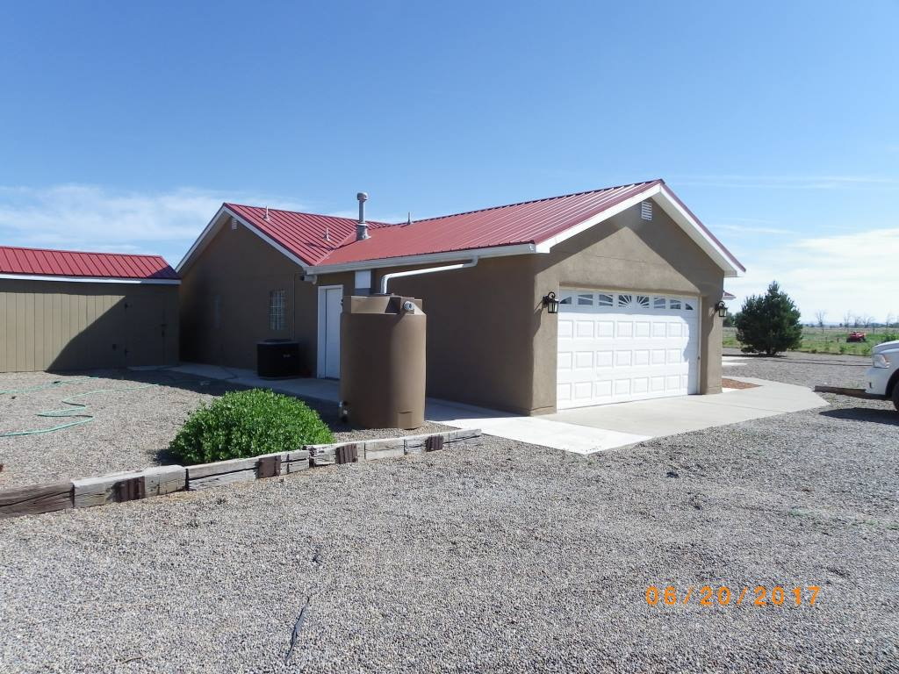
Water Harvesting
500 Gallon Tank

Slide 14
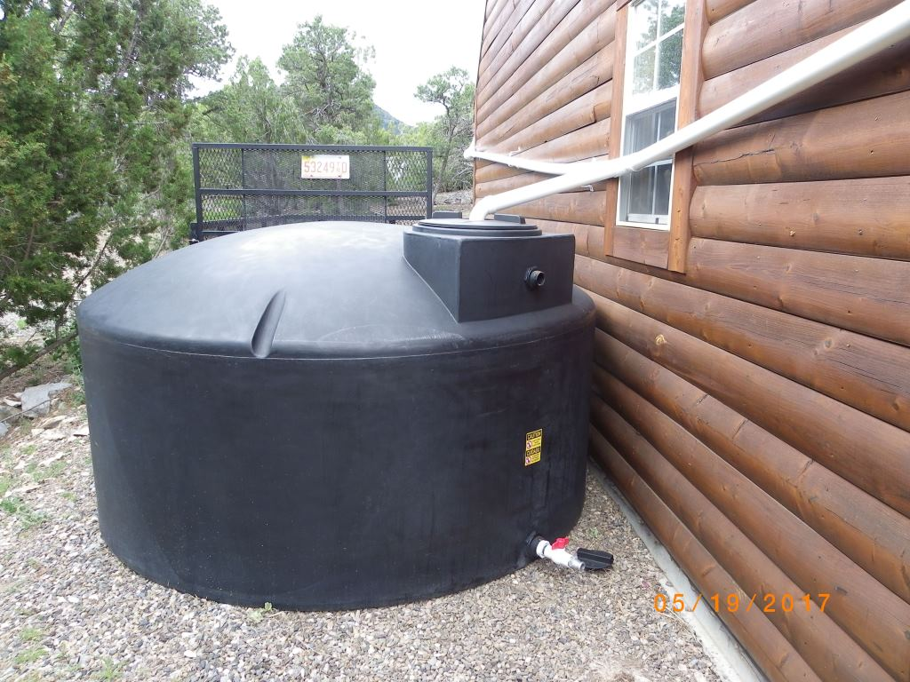
3000’ Gallon Rain Water Harvesting Units
1200 Gallon tank

Slide 15
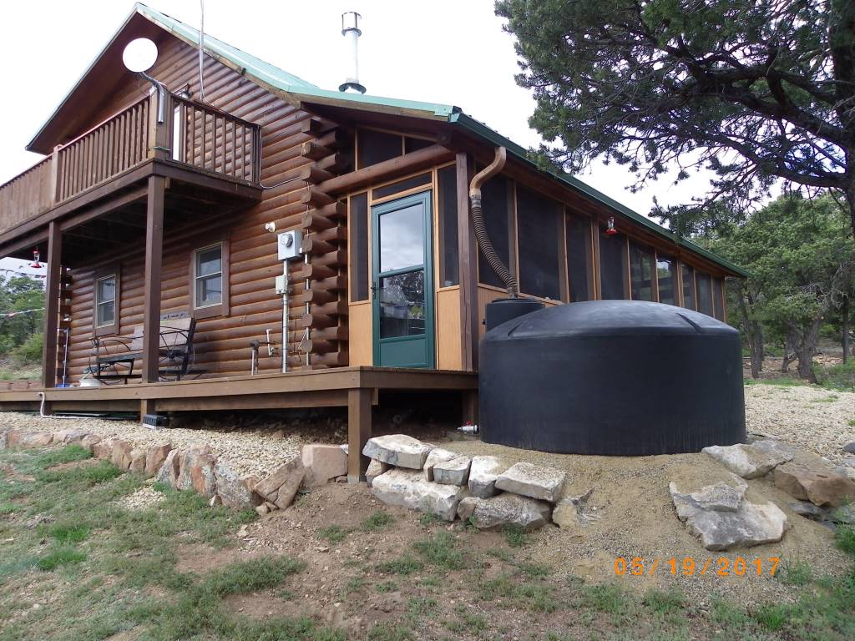
1200 Gallon Tank

Slide 16
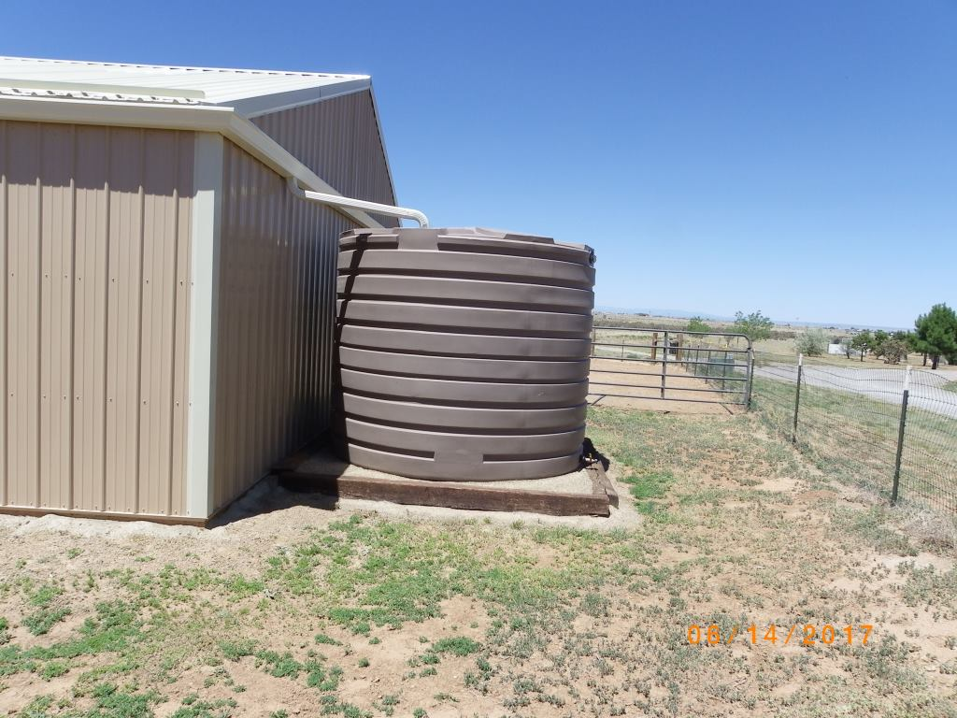
2825Gallon tank

Slide 17
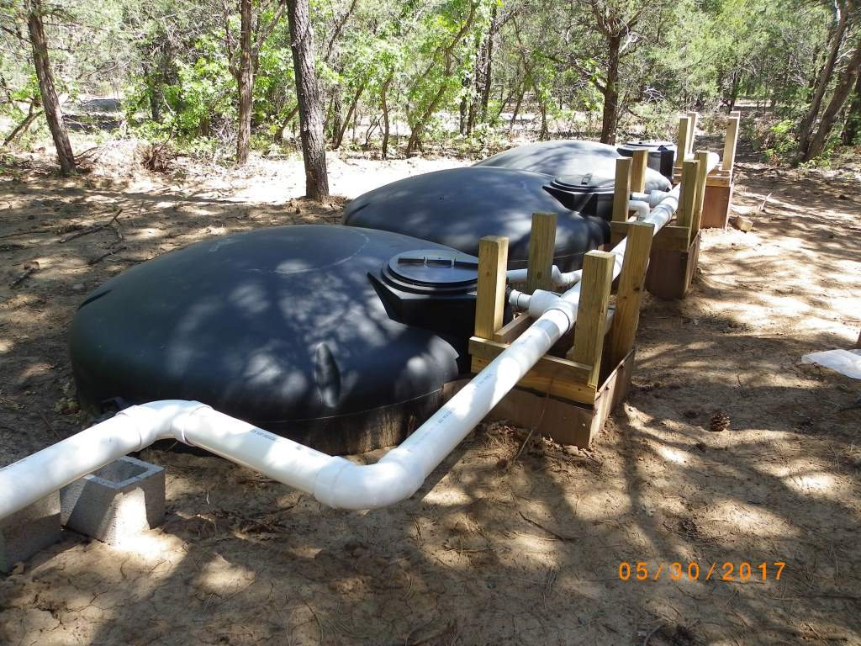
3-1600 Gallon Tanks plumbed together for potable in-home use system

Slide 18
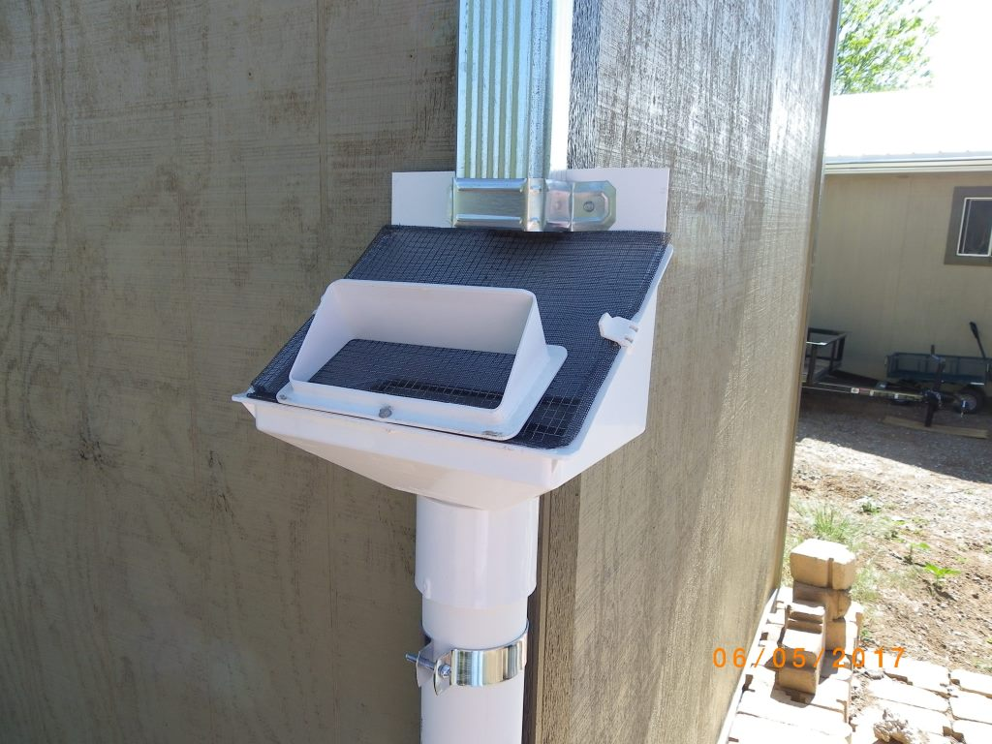
Downspout Screen deflects roof debris from getting into tanks

Slide 19
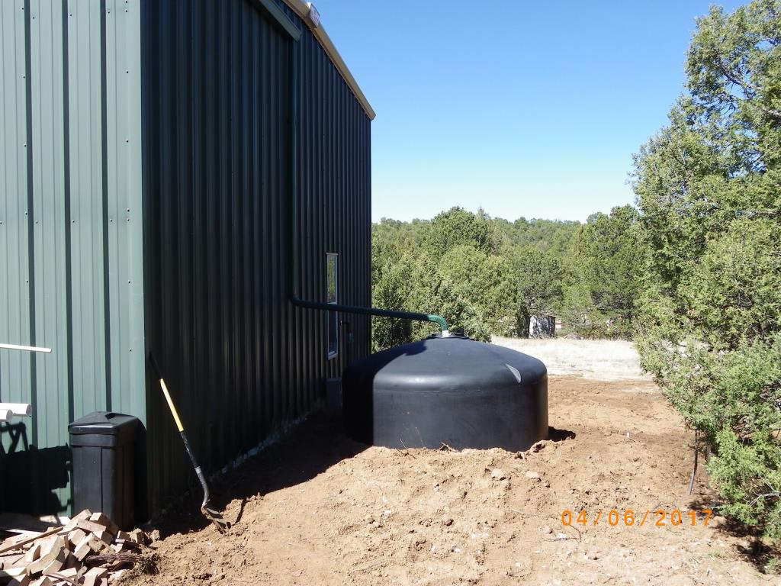
1600 Gallon tank with underground piping to indoor filtration system

Slide 20
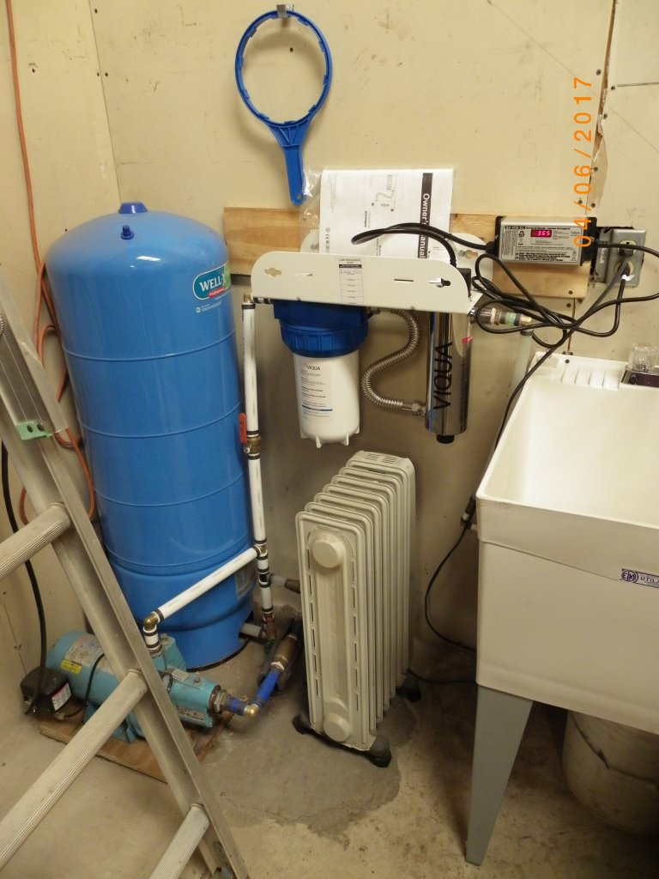
Pressure tank UV disinfection
set-up for potable water use

Slide 21
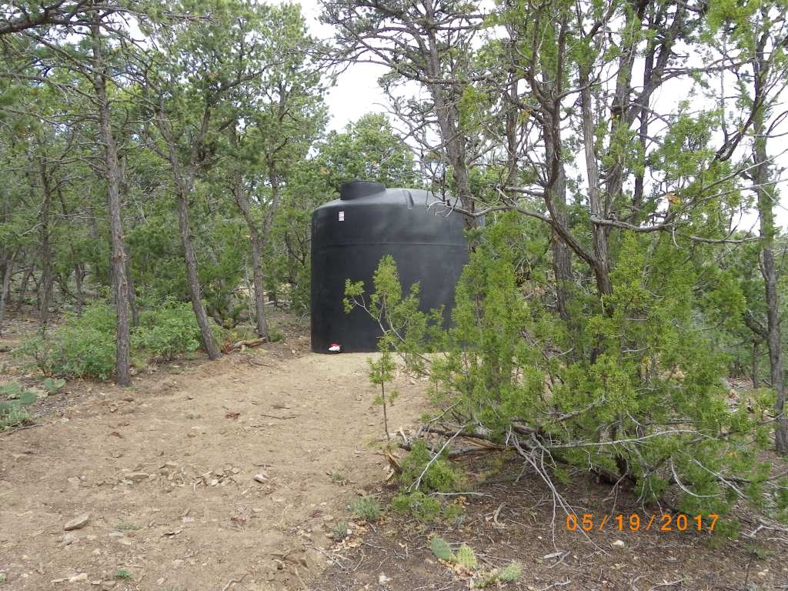
Additional Storage Tank – 3000 gallon above home for gravity flow landscape use

Slide 22
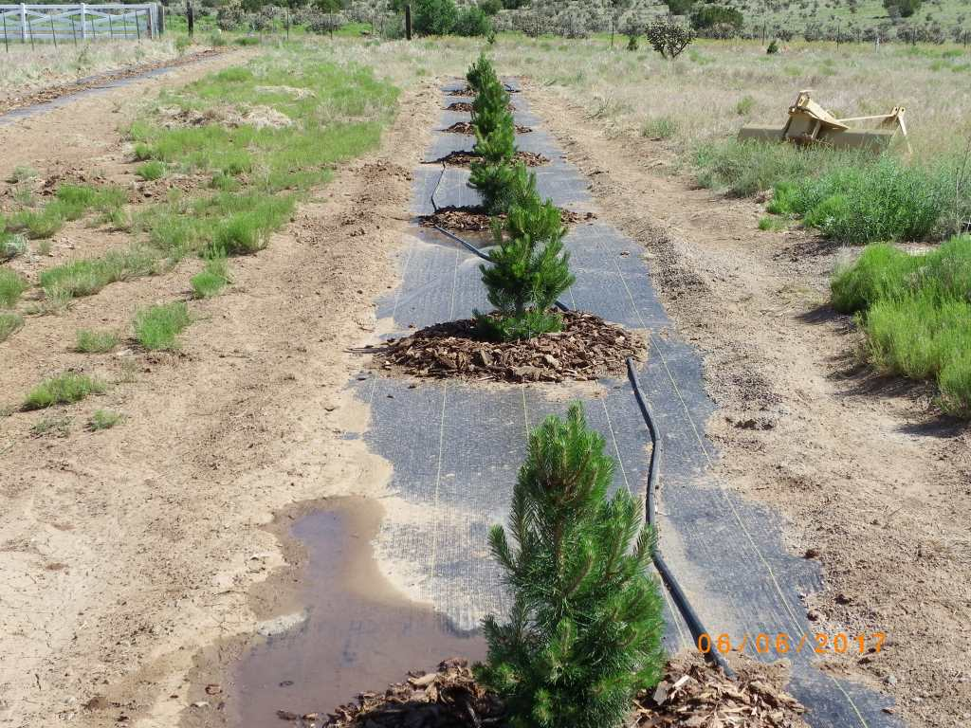
Austrian Pine transplants for newly installed windbreak with drip irrigation system

Slide 23
Watershed Health Program (forest thinning)

Slide 24
The forest thinning program provides financial and technical assistance for watershed management focusing on restoration projects on private and state land.
These projects include:
Forest Stand Improvement
Defensible Space
Brush Management
Fire Breaks

Slide 25
The next few slides
are before and after photos
of Thinning Projects.

Slide 26
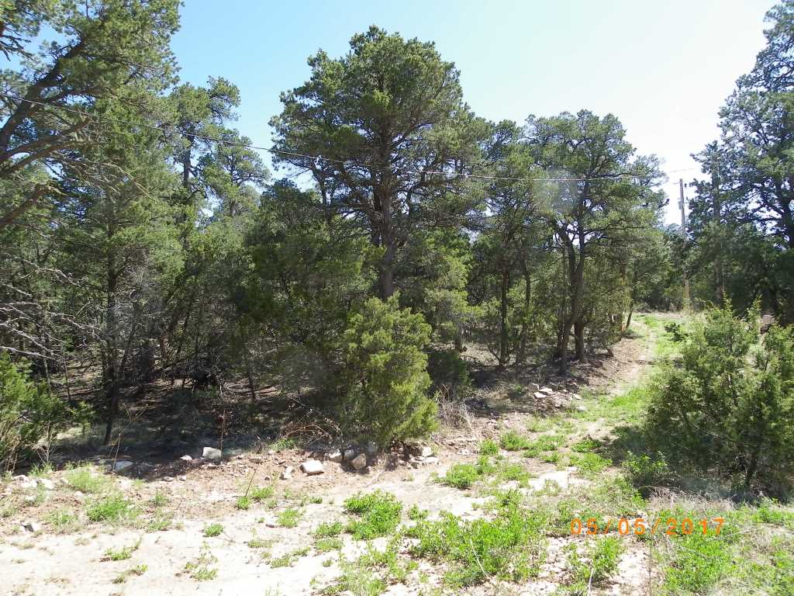

Slide 27
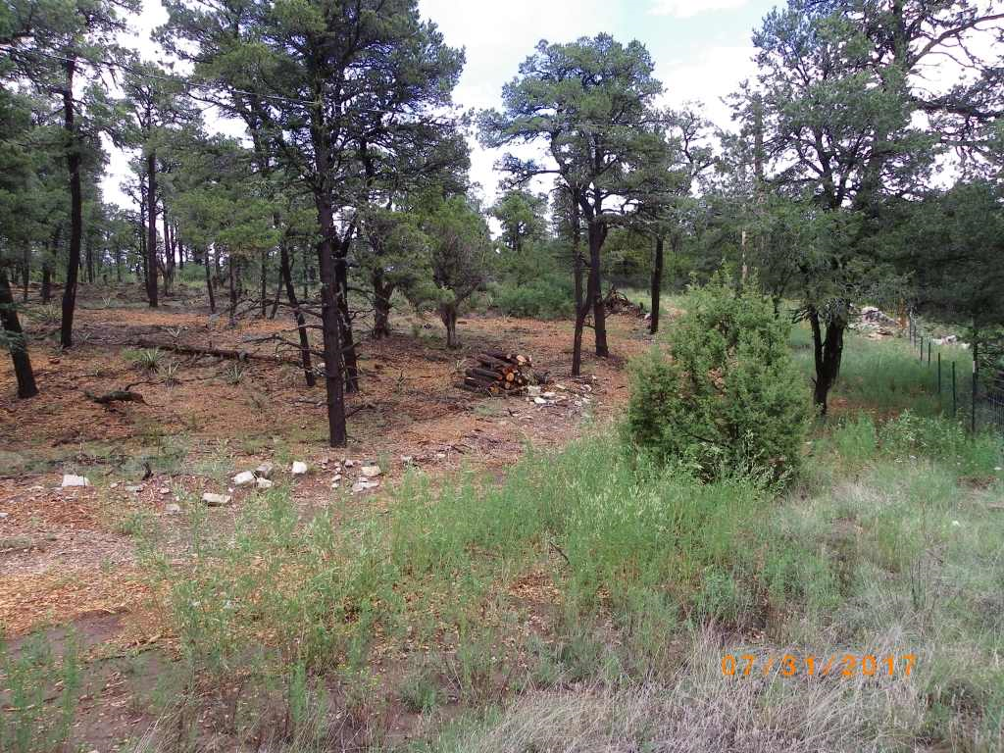

Slide 28
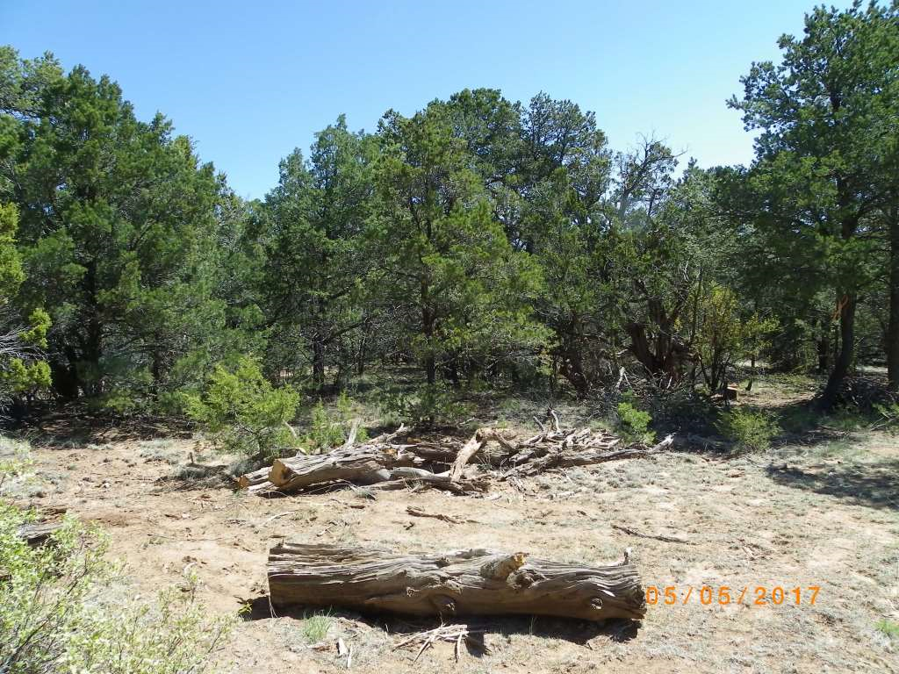

Slide 29
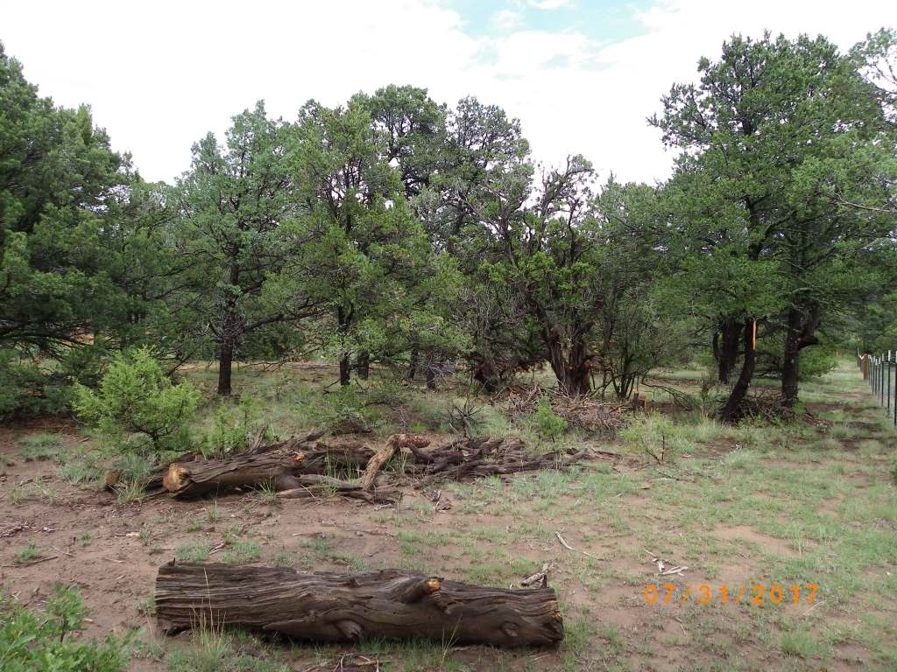

Slide 30
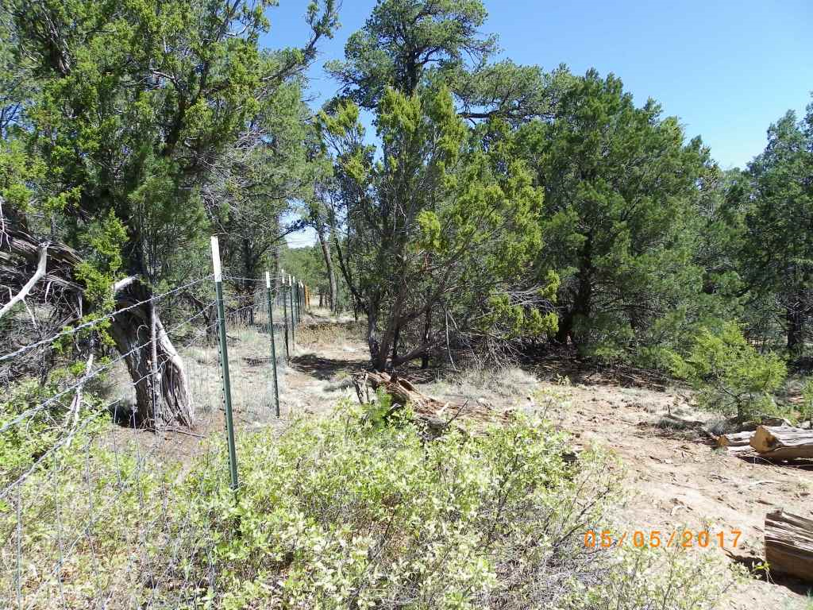

Slide 31
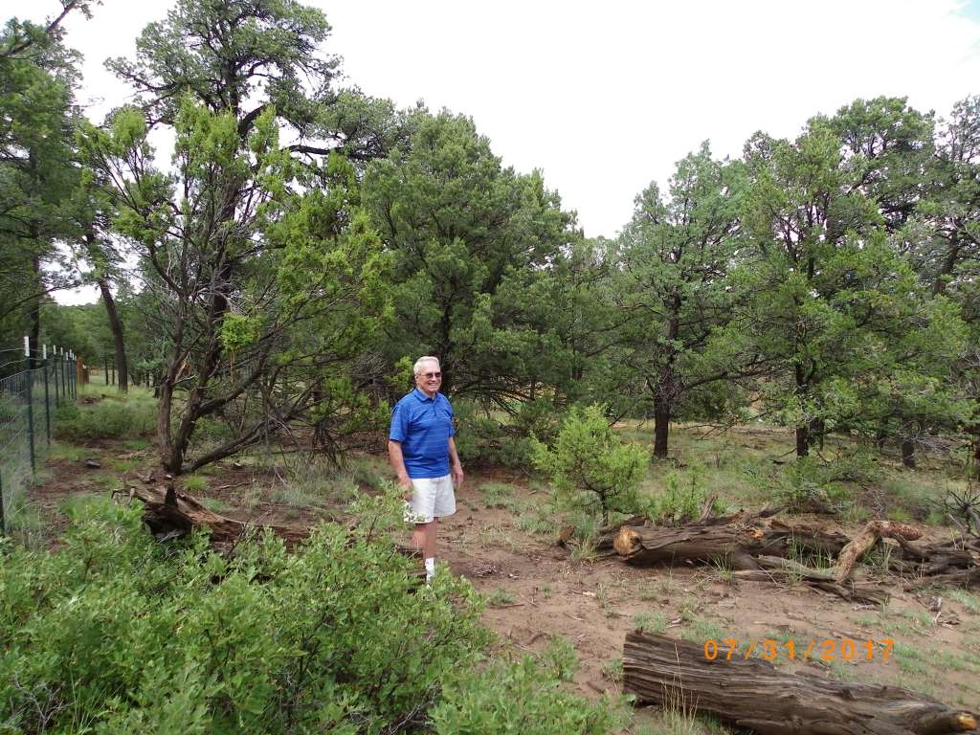

Slide 32
Dog Head Fire
Restoration Project

Slide 33
Dog Head Fire ~ June 2017
A total of 17,912 acres burned in this fire. 10,773 acres – Chilili Land Grant 6,600 acres – US Forest Service 436 acres – Private Lands BLM, State of NM, and the Pueblo of Isleta each had burn areas of less than 100 acres 56 Homes/structures lost

Slide 34
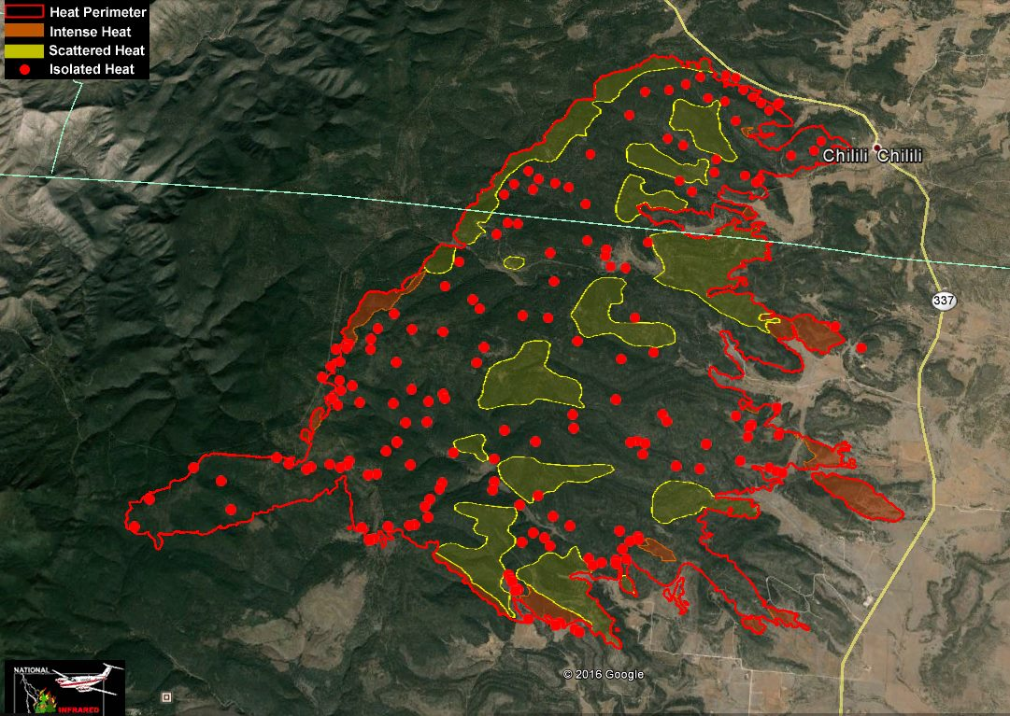

Slide 35
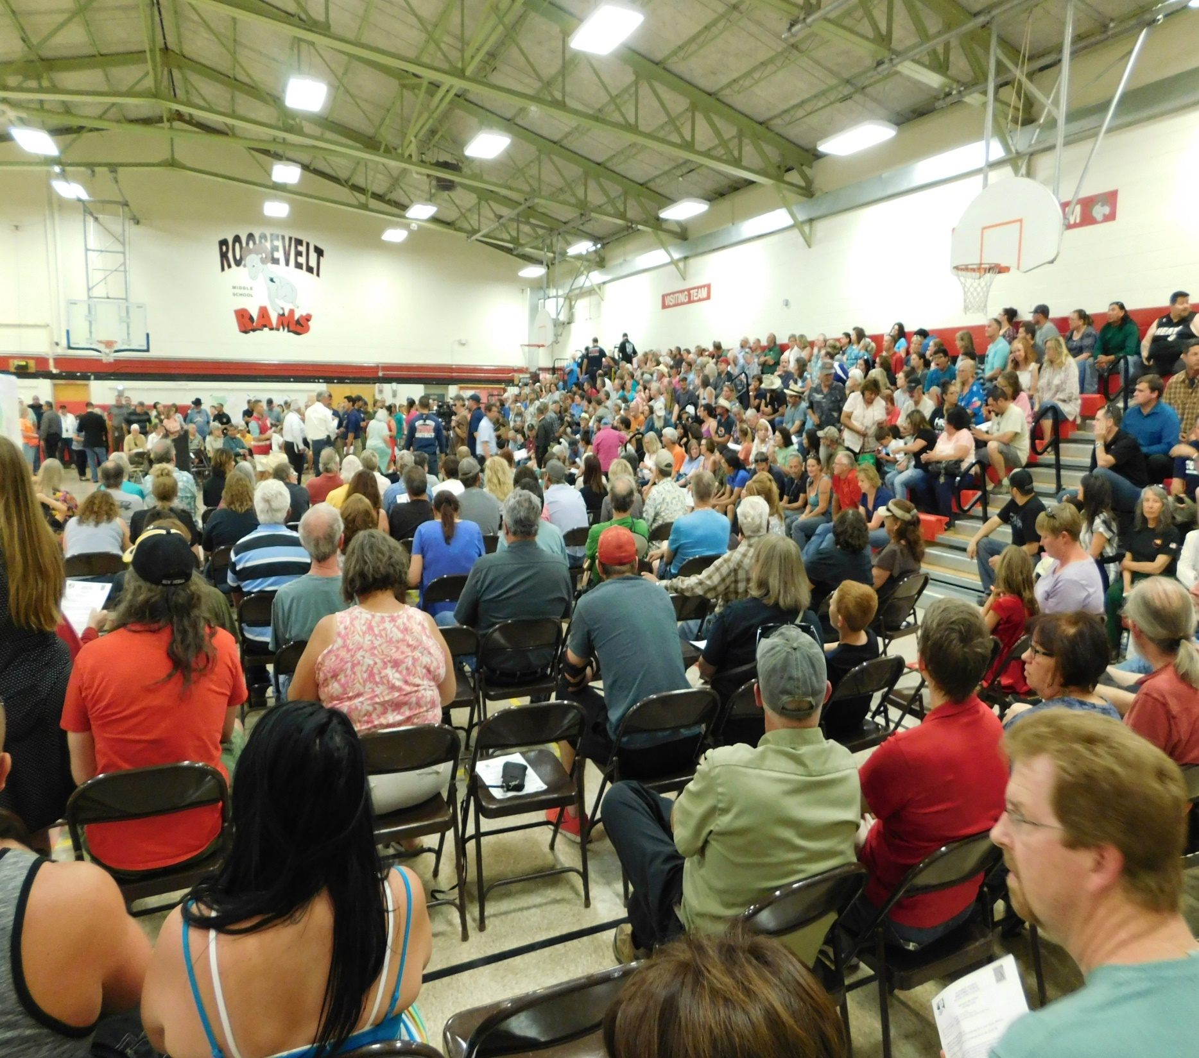
Dog Head Fire Public Meetings were held in Tijeras, Moriarty, Estancia and Torreon

Slide 36
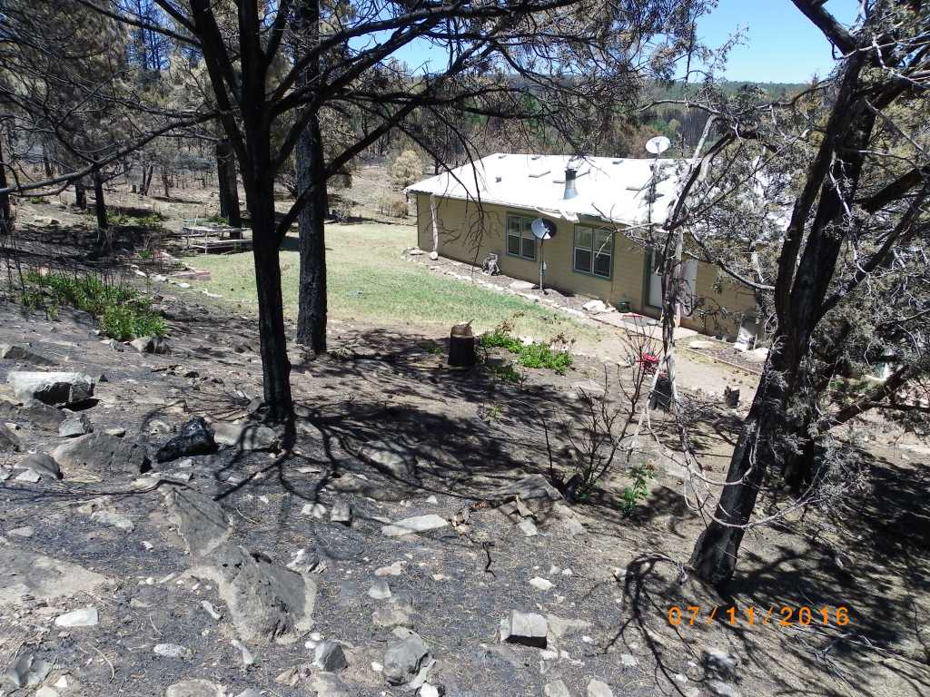
Defensible Space Treatment by ESWCD
HOME WAS SAVED!!

Slide 37
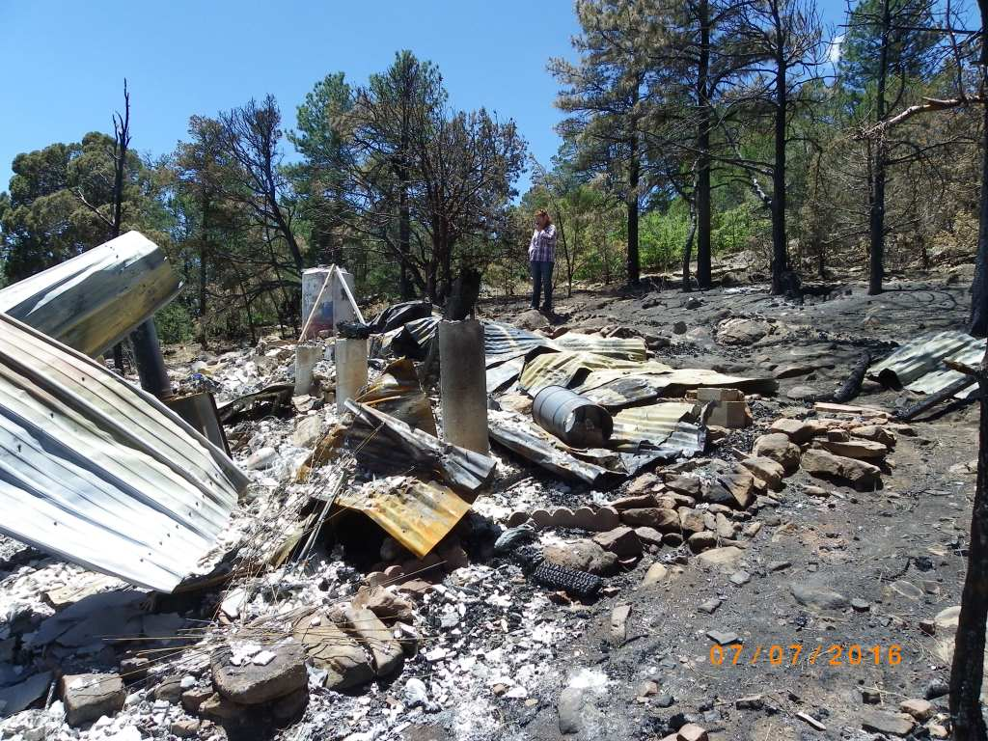

Slide 38
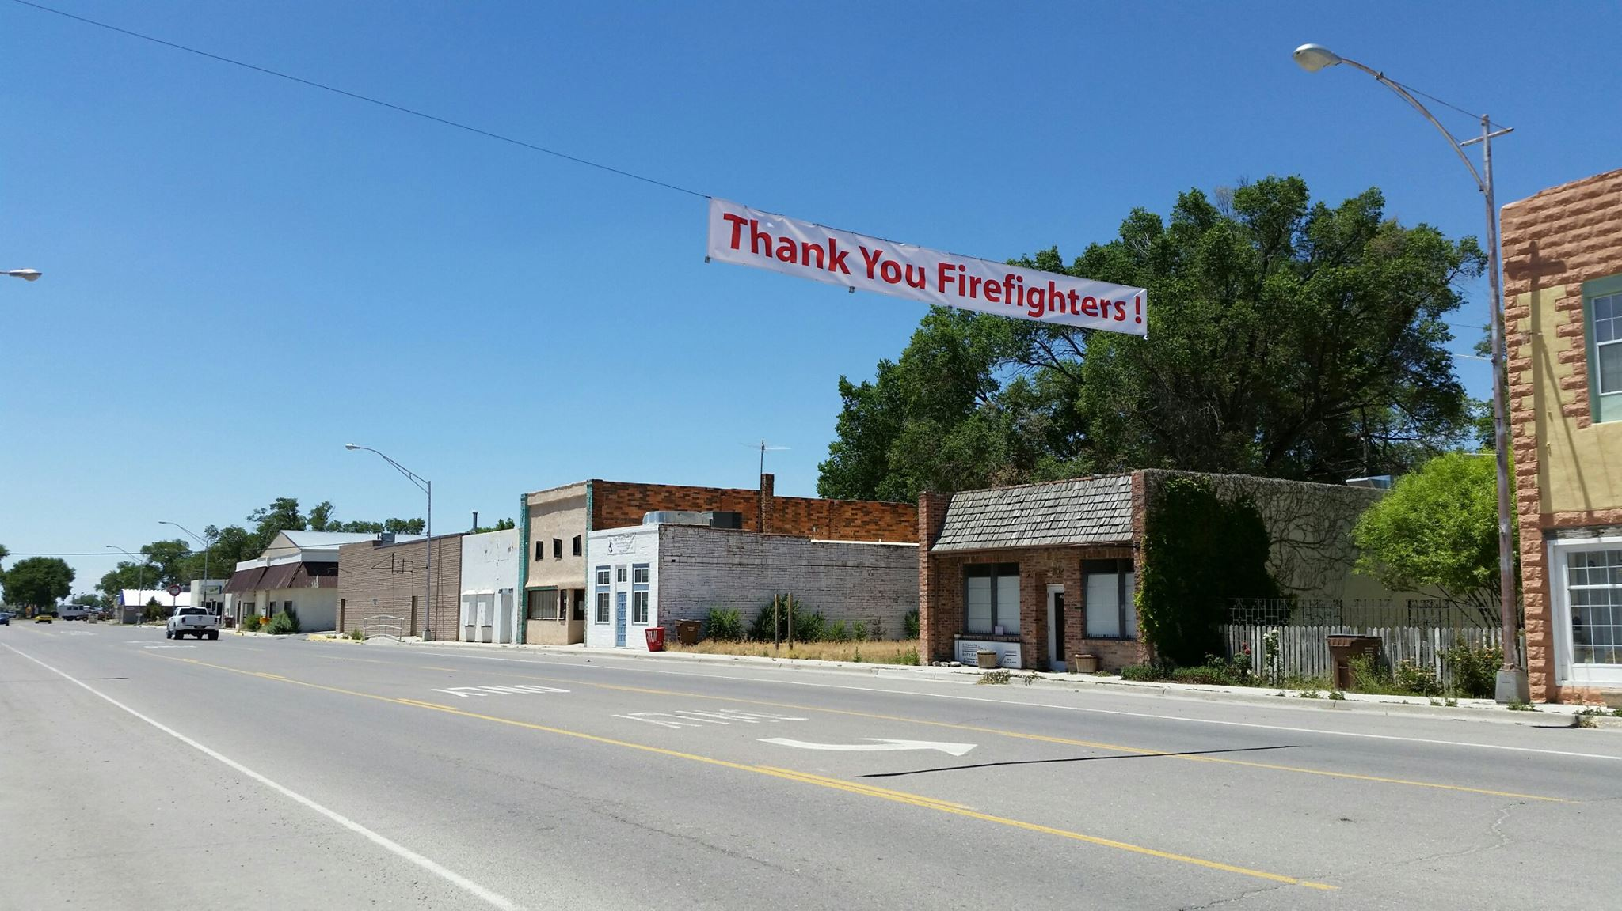
Although there was loss of properties, thankfully there were no lives lost!

Slide 39
Dog Head
Post-Fire
Rehabilitation

Slide 40
Post-fire rehabilitation is necessary to re-establish structure and function, and protect and restore critical habitat, riparian areas and watersheds. Some practices include: Erosion Control Structures Tree Felling Mastication Reseeding

Slide 41
The Edgewood SWCD Staff and partners began the Dog Head Fire Rehabilitation Coordinated Group within 1 week of the fire. Along with the Edgewood District, members included:
Congressional Staff
Federal Agencies
State Agencies
County Agencies
Private Companies
Community Members

Slide 42
Staff secured funding through the Emergency Watershed Protection Program (EWP) through NRCS for post fire restoration in the amount of $270,952.50.
Edgewood SWCD was responsible for a 25% match of $90,317.50.
This provided funding for projects along Aceves Road and within the Chilili Land Grant.

Slide 43
The Pueblo of Isleta, Chilili Land Grant, the Army Corps of Engineers and a HESCO Rep. installed HESCO baskets to protect the bridge in Chilili.
These are used for emergency flood or long-term sustainability projects.

Slide 44
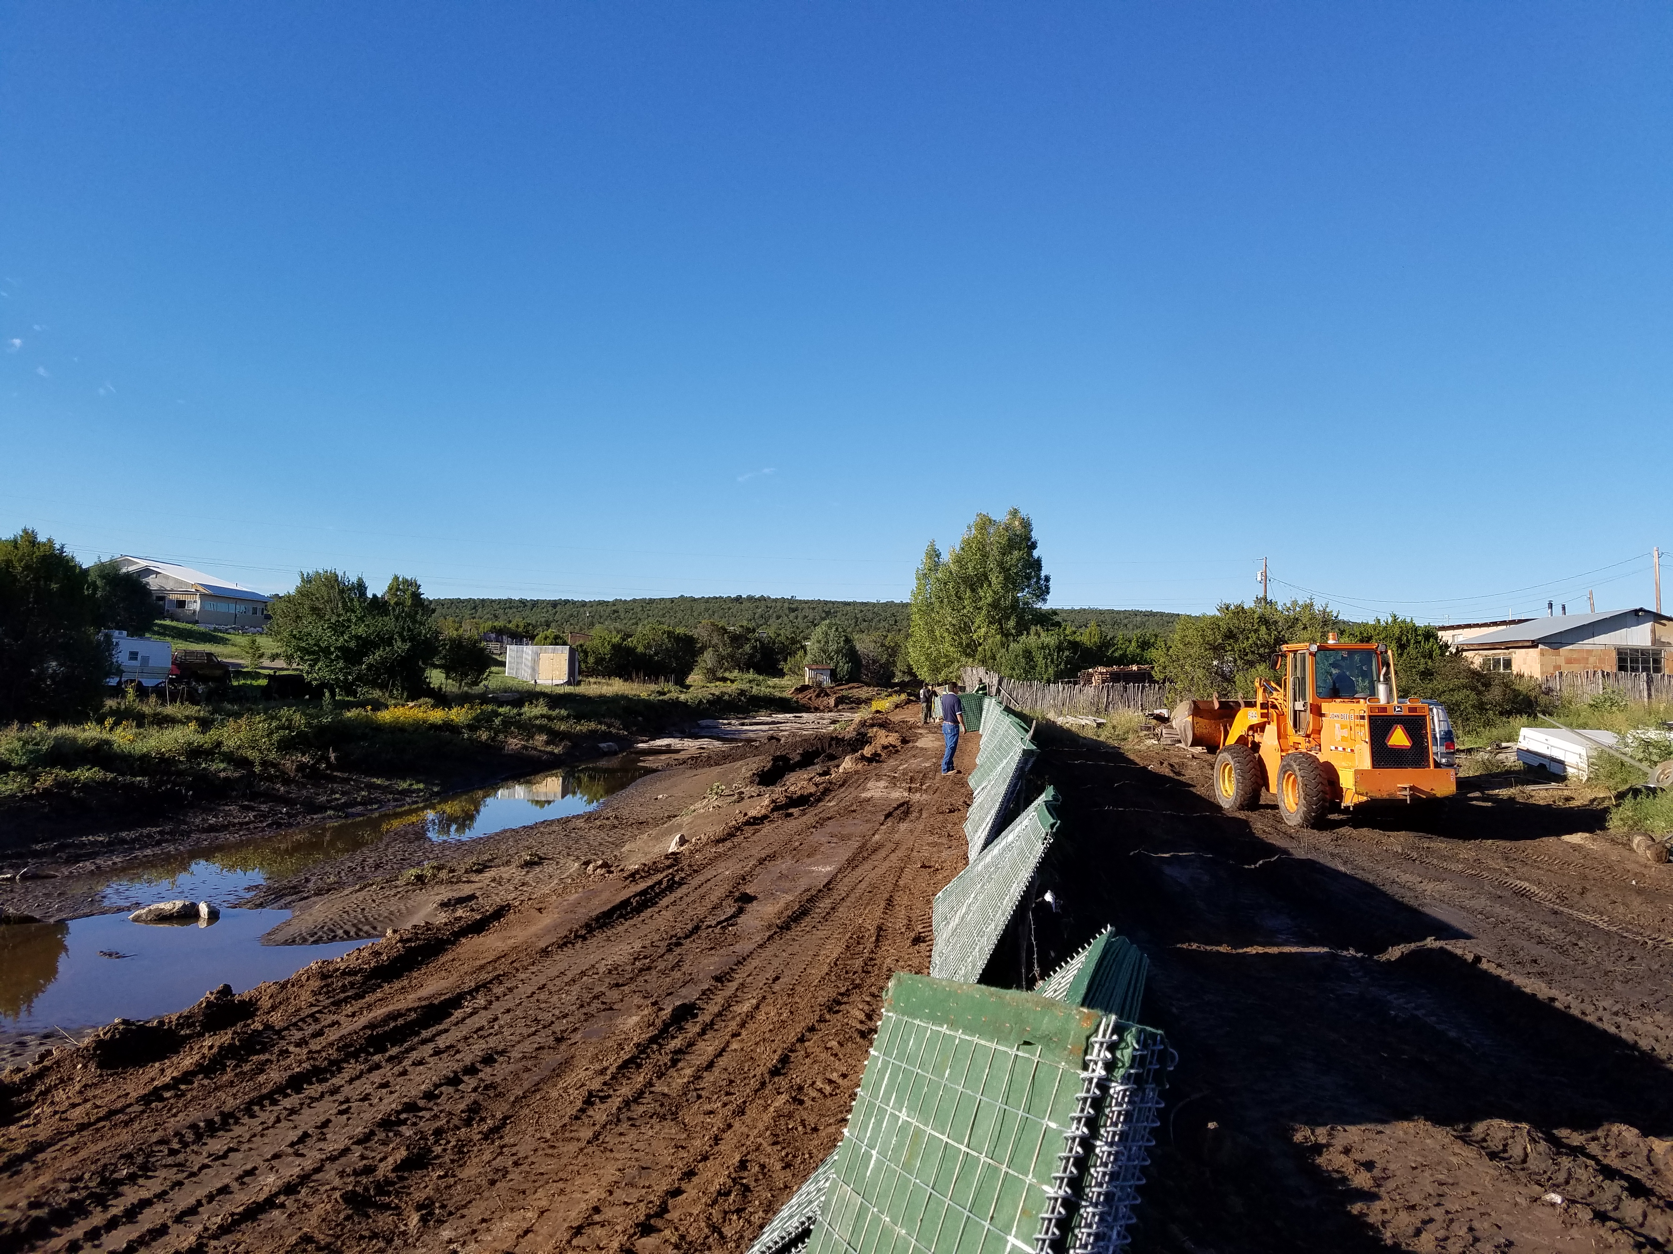

Slide 45
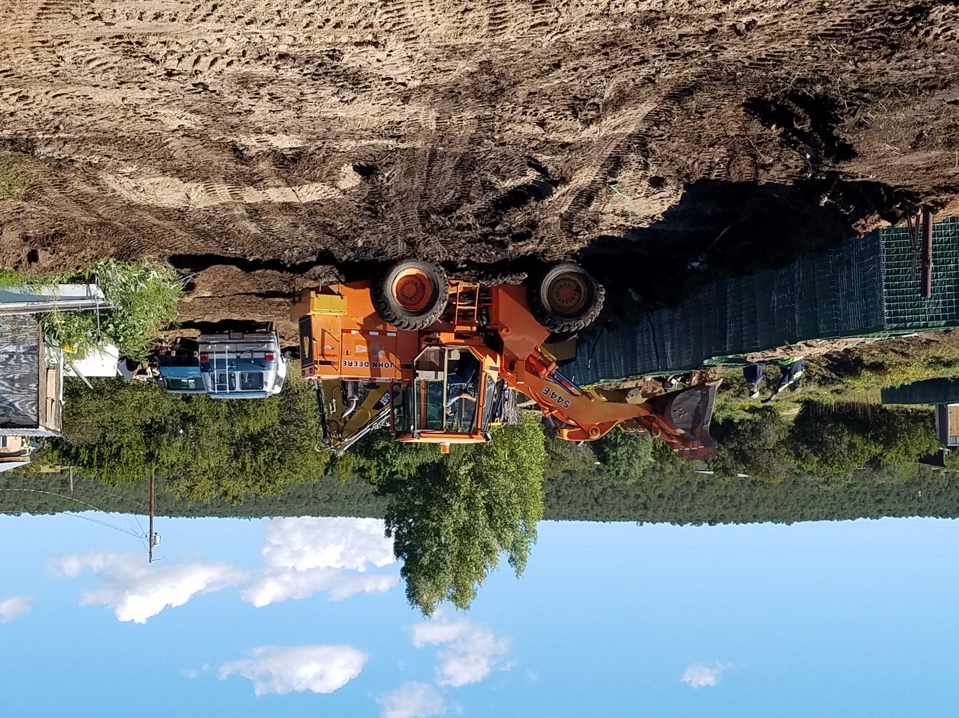

Slide 46
HESCO earth-filled barriers have a significant advantage over traditional sandbags, in terms of speed and structural integrity, time and labor requirement for installation.

Slide 47
Vulcan Material Company donated 769.90 tons of sand for the Hesco Basket Construction. This totaled more than $21,000 in materials alone!
Nu-Star Pipeline provided match-funding for the projects along the pipeline above Chilili Land Grant.

Slide 48
Edgewood SWCD provided Cost-Share Assistance to area residents who did not qualify for EWP Funding.
This local funding provided a maximum reimbursement of $4500.

Slide 49
Projects which were completed include:
Mastication
Tree Felling
Erosion Control Structures
Re-seeding
Re-building of burned fence
Chipping of downed wood cut by fire-fighters

Slide 50
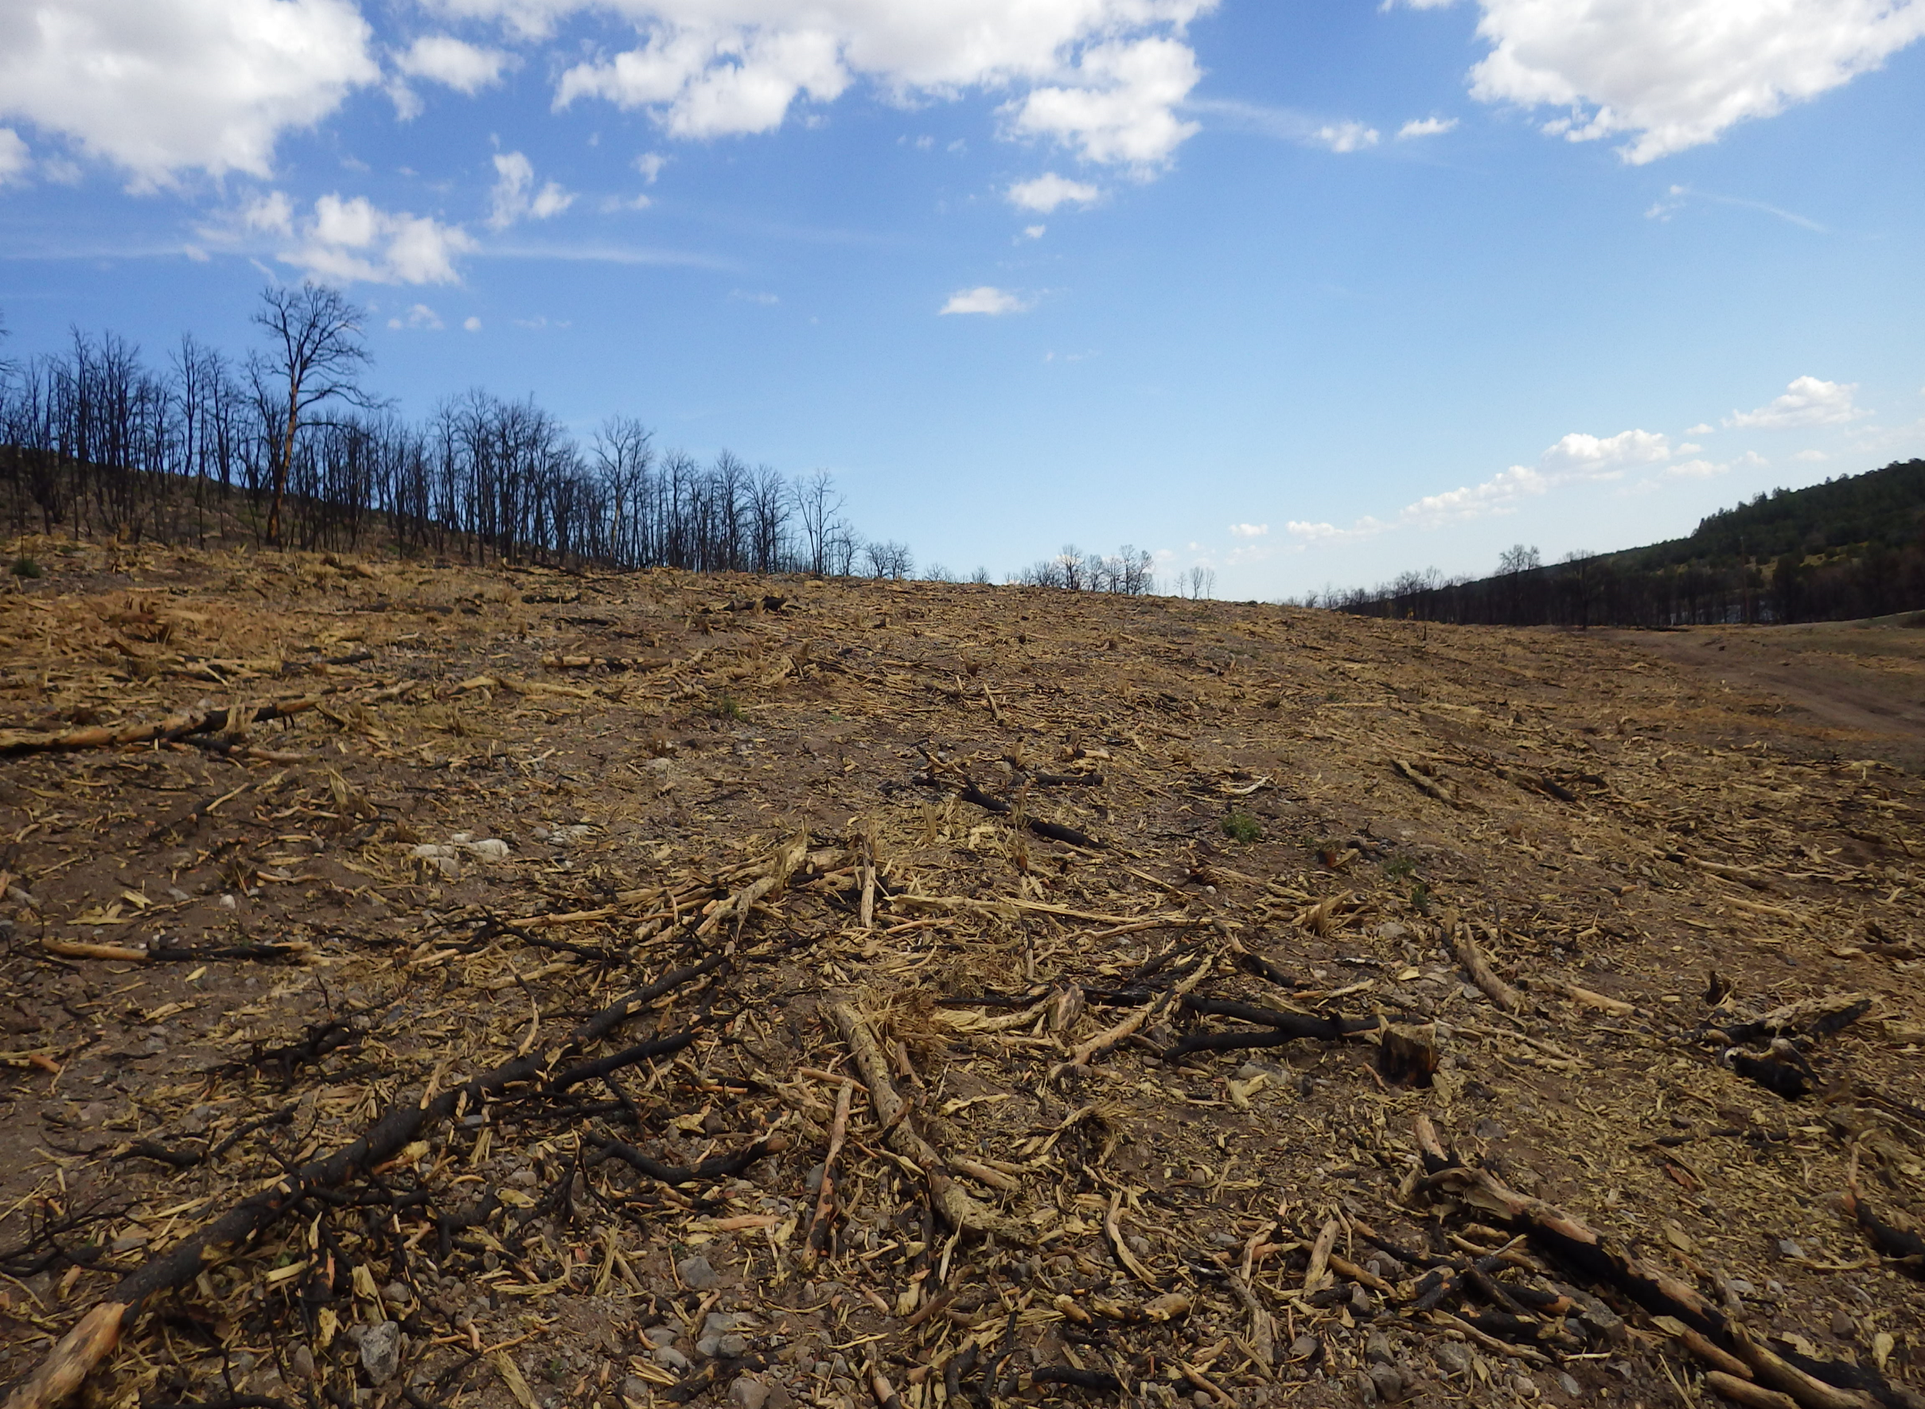
Mastication of Burned Trees

Slide 51
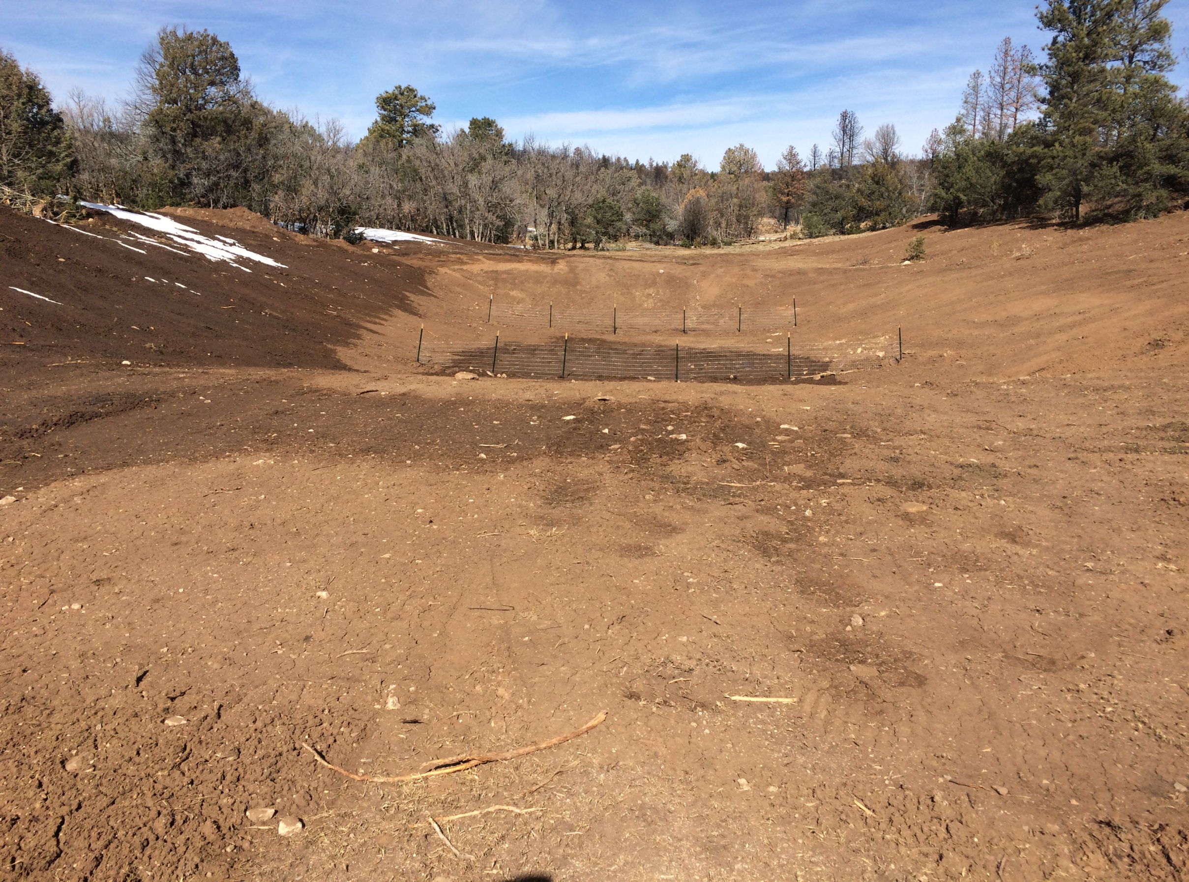
Pit Tank with Silt Fence to collect debris

Slide 52
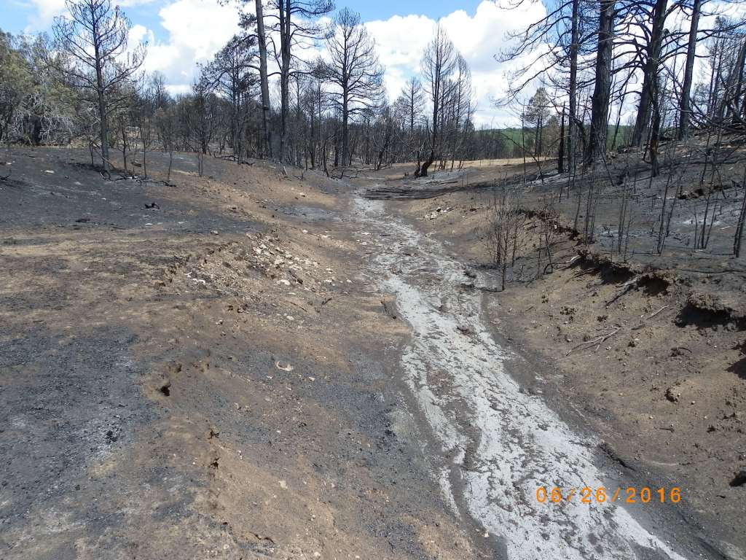
Staff is working to secure funds for future erosion issues.

Slide 53
A total of $494,893.32
was allocated to the
Dog Head Fire Rehabilitation through the
Edgewood SWCD
from Private, Local, State and Federal Funding.

Slide 54
Additional
Edgewood
Soil & Water
Conservation District
Programs Include:

Slide 55
Tree & Shrub Sales
Noxious Weed Management
Native Grass & Wildflower Sales
Dog Head (CFRP) Collaborative Forest Restoration Project
Assisting USFS with the Cibola 1985 Forest Plan Revision

Slide 56
The Edgewood SWCD Board is committed to ensuring staff has the most up-to-date information and trainings available that is beneficial to our landowners.

Slide 57
Staff trainings include:

Slide 58
Governmental Budgeting
Forest Restoration
NM Organic Farming
Grant Writing
Supervisor Election
Wildfire Preparedness
Public Pesticide Certification
Certified Procurement Officer Certification
Rainwater Harvesting
Leadership Skills
Conflict Management

Slide 59
Partnerships

Slide 60
Edgewood SWCD is committed to our partners.
We have hosted several trainings and meetings that benefit our landowners in cooperation with neighboring Districts, state and federal partners, along with local organizations.
They include the following:

Slide 61
Grant Writing Training
New Mexico Coalition of Conservation
District’s Annual Meeting
Post Dog Head Fire Restoration Meeting
Food Preserving Workshop
NM Department of Agriculture –
Election Training

Slide 62
2nd Annual Beekeeping Workshop
Natural Resources Conservation Service
Local Work Group Meeting
Garden Club Meeting
Estancia Basin Water Planning Meetings
NM Game & Fish Crane Check Point
Native Seed Exchange Workshops

Slide 63
Tri-County Herd Health Symposium
Cooperative Weed Management
Training
Estancia Basin Watershed Health &
Monitoring Meetings
Mountainair Collaborative Meetings
Sandia Collaborative Meeting

Slide 64
A Special “Thank You” to Claunch-Pinto
Soil & Water
Conservation District
for our continued partnership!

Slide 65
Kelly Smith & Brenda Smythe hold Public Pesticide Applicators Licensure.
The District also has a secure pesticide storage facility that is certified by the NM Department of Ag.

Slide 66
As mandated by New Mexico Governor, Susana Martinez,
Edgewood Soil & Water Conservation District’s Manager became a Certified Procurement Officer (CPO) as of July 2016.
This insures state procurement laws are being followed.

Slide 67
Edgewood SWCD
Base Funding

Slide 68
The Edgewood SWCD receives funding from the following sources:
State of NM Base Funding
State Land Office Rental
Tree & Seed Sales
Mill Levy Collection

Slide 69
Through a resolution, the Edgewood District held a referendum to vote for a mil levy for the property owners with the district boundaries.
A mil levy is one mil of 1/3 of the property’s net taxable value.

Slide 70
Example:
A $30,900.00 property is assessed at 10,299 (1/3 of property value)
The Mill Levy Tax is $10.30 per year.
The mil levy is assessed at the county tax assessor’s office.

Slide 71
2016-2017
Project Funding

Slide 72
$3,948.11
Private Funding for Dog Head Rehabilitation
$119,000.00
Non-federal Lands (NM State Forestry)
$100,069.51
USFS Collaborative Forest Restoration Program Funding (Year 3)

Slide 73
$42,826.00
NM Homeland Security Disaster Assistance
$270,847.50
Emergency Watershed Protection Funding
$150,000.00
NM Board of Finance Emergency Funding

Slide 74
Grant funding changes year to year.
Staff is continually searching for further grant sources for future conservation projects!

Slide 75
Upcoming Projects!

Slide 76
Edgewood SWCD Signed Cooperative Agreement
with US Forest Service.

Slide 77
Partnership with San Antonito Elementary School – Gifted Education Class and SWCA Environmental Consultants
for post-fire restoration work
in Chilili.

Slide 78
New partnership with Santa Fe County Fire Department
and
Santa Fe-Pojoaque SWCD for additional projects within Santa Fe County.

Slide 79
On behalf of the
Board of Supervisors
and Staff,
Thank you for
your continued support
of our programs and taking time out of your busy schedules
to join us tonight!

Slide 80
I would like to take a moment
to thank my Team
for the great work
they do to help
ensure the landowners
get courteous and
professional assistance!
We are a Great Team!!

Slide 81
"Teamwork is the ability to work together toward a common vision.
The ability to direct individual accomplishments toward organizational objectives.
It is the fuel that allows common people to attain uncommon results."
Andrew Carnegie US Philanthropist

